Slide 1
Text Mining – Techniques, Methods and Tools
Presented by Sanika Deshpande
11/17/2016

Slide 2
What is Text Mining ?
Text Mining is the process of deriving high-quality information from text.
Make unstructured data usable
Extraction of information required by user
Requires natural language processing

Slide 3
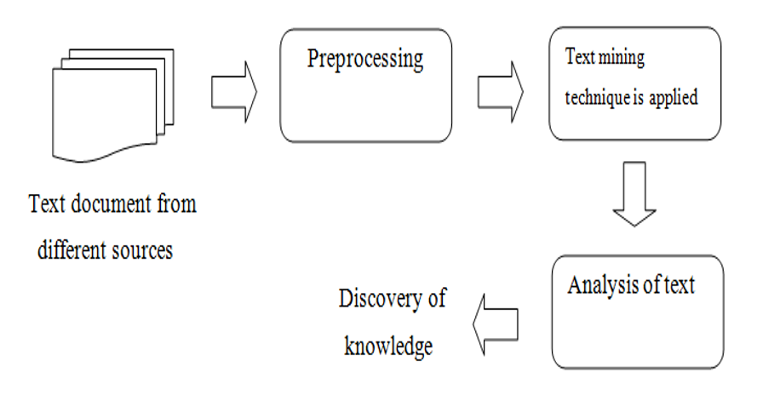
Process of Text Mining
Figure 1 : Process of Text mining (Sonali Vijay Gaikwad, 2014)

Slide 4
Methods in Text Mining
Term Based Method
‘Term’ – ‘Word having semantic meaning’
Problem of Polysemy and synonymy.
Phrase Based Method
‘Phrase’ – information which carries more semantics
Less ambiguous
Problem of low frequency of occurrence and redundant and noisy phrases
Concept Based Method
At Sentence or document level – Term frequency
Conceptual Ontological Graph – derive semantic
Optimization of representation and removal of noise and ambiguity
Pattern Taxonomy Method
Pattern – Taxonomy – using is-a relationship
Reduction of low frequency and misinterpretation
Best among all others

Slide 5
Techniques of Text Mining
Information Extraction
Topic Tracking
Summarization
Categorization
Clustering
Concept Linkage
Information Visualization
Natural Language Processing

Slide 6
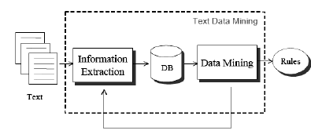
Information Extraction
Figure 2: Text mining framework based on IE (Vishal Gupta, 2009)

Slide 7
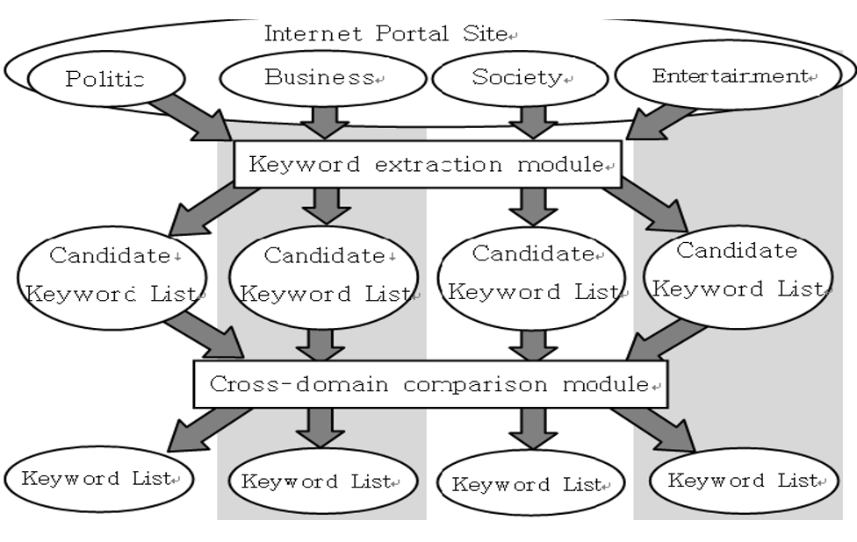
Topic Tracking – Keyword Extraction System
Figure 3: Keyword Extraction System (Vishal Gupta, 2009)

Slide 8
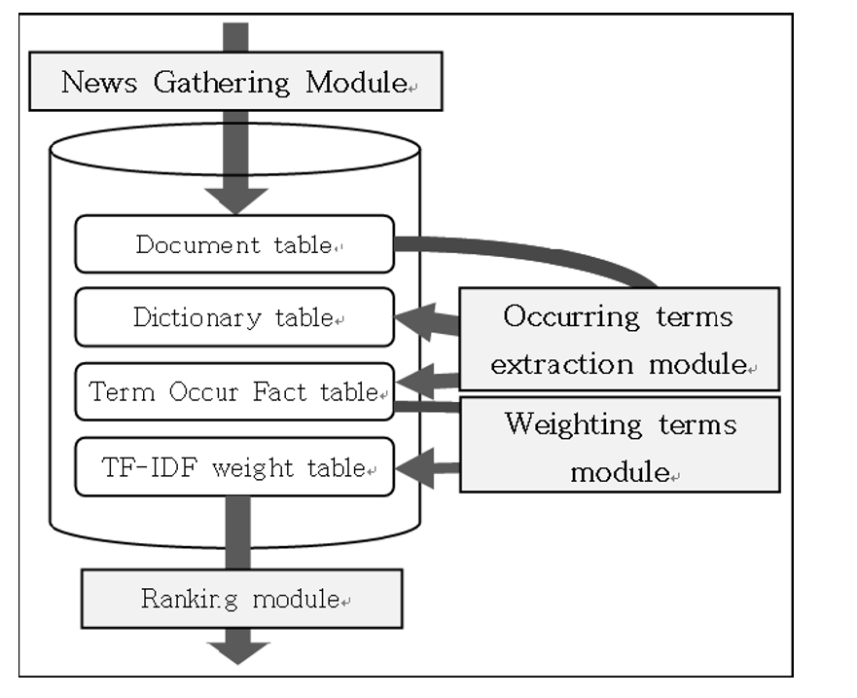
Topic Tracking – Keyword Extraction Module
Figure 4: Keyword Extraction Module (Vishal Gupta, 2009)

Slide 9
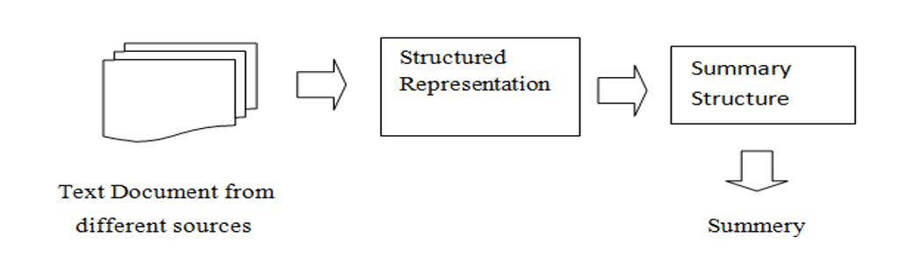
Summarization
Sentence Extraction
Position Information
Figure 5: Summarization (Sonali Vijay Gaikwad, 2014)

Slide 10
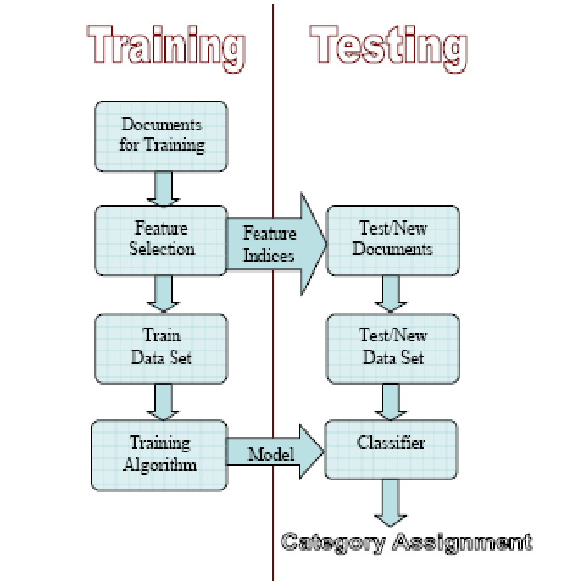
Categorization
Figure 6: Text categorization (Vishal Gupta, 2009)

Slide 11
Clustering
Stop Word Removal – pronouns , prepositions
Stemming – work, worker ,working and worked
Filtering – reduce the dimension of document

Slide 12
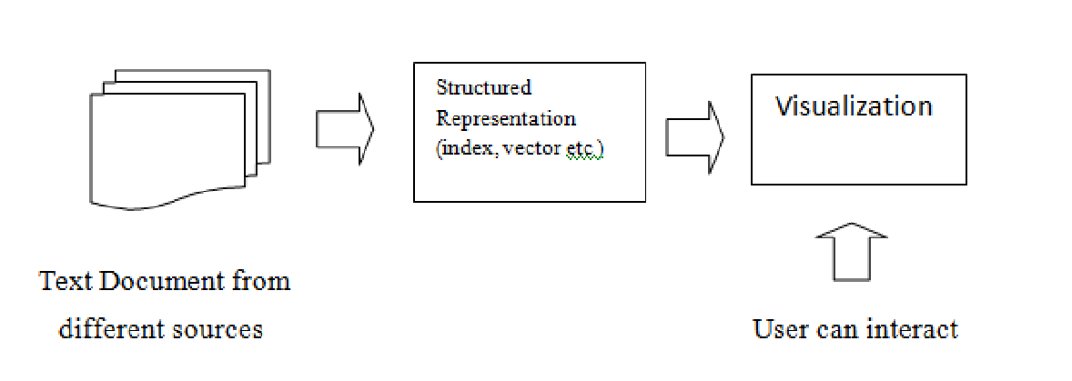
Information Visualization
Figure 8 : Visualization (Sonali Vijay Gaikwad, 2014)

Slide 13
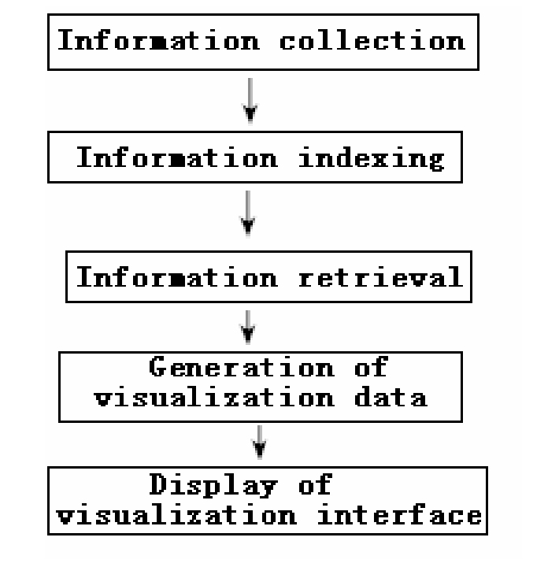
Information Visualization – InfoVis model
Figure 9: Visualization Model called InfoVisModel (Vishal Gupta, 2009)

Slide 14
Tools for Text Mining
Sentiment Analysis
reviews positive, negative or neutral
Affective Norms for English Word Tool, WordNet , TextBlog
Term Frequency – Inverse Document Frequency (TF-IDF)
Keeping track of meaning full word that appear frequently
Name Entity Recognition (NER)
Recognizes nouns – for person , date , location - meaning
Event Extraction
Focus on noun – relationship

Slide 15
Advantages Of Text Mining
Efficiency – time reduction
Unlocking ‘hidden’ Information and Developing new Knowledge
Exploring New Horizons

Slide 16
Challenges
Natural Language Issues - ambiguity problem
IE Issues – No relations only text

Slide 17
Current Trends of Text Mining
Fight against terrorism – text , videos extraction
Curing diseases with the help of Bio-Informatics – predict current from history
Semantic Web – organize unstructured web data

Slide 18
Conclusion
Extraction of useful information is text mining
Predicting current status from history is possible
Use of automated tools makes text mining process easy for industry

Slide 19
References
Kaushik, M. L. (2013). Text Mining - Scope and Applications. Journal of Computer Science and Applications.
Luca Scagliarini, M. V. (2016). The definition of text mining, it only seems simple but the real activity is not. Retrieved from Expert system symantic intelligence: http://www.expertsystem.com/definition-of-text-mining/
Merrett, R. (2015). 5 tools and techniques for text analytics. Retrieved from CIO from IDG: http://www.cio.com.au/article/575209/5-tools-techniques-text-analytics/?
Monika D. Khatri, S. D. (2014). International Journal of Advance Research in Computer Science and Management Studies . History and Current and Future trends of Data mining Techniques .
Shaidah Jusoh, H. M. (2012). Techn TTeecchhnn Techniq iiqq iques, Applications and Challenging Issue in Text Mining . IJCSI International Journal of Computer Science Issues.
Sonali Vijay Gaikwad, A. C. (2014). Text Mining Methods and Techniques . International Journal of Computer Applications .
U. Ackermann, B. A. (2014). SpeeData: Multilingual Spoken Data Entry. IEEE.
Vishal Gupta, G. S. (2009). JOURNAL OF EMERGING TECHNOLOGIES IN WEB INTELLIGENCE. A Survey of Text Mining Techniques and Applications .

